Slide 1
NWIC Work Request Form
Brief demonstration
January, 24, 2019
Facilitated by: Stephanie Tallett
Human Factors Engineering, Health Informatics Division
Office of Health Informatics (10A7)
Veterans Health Administration

Slide 2
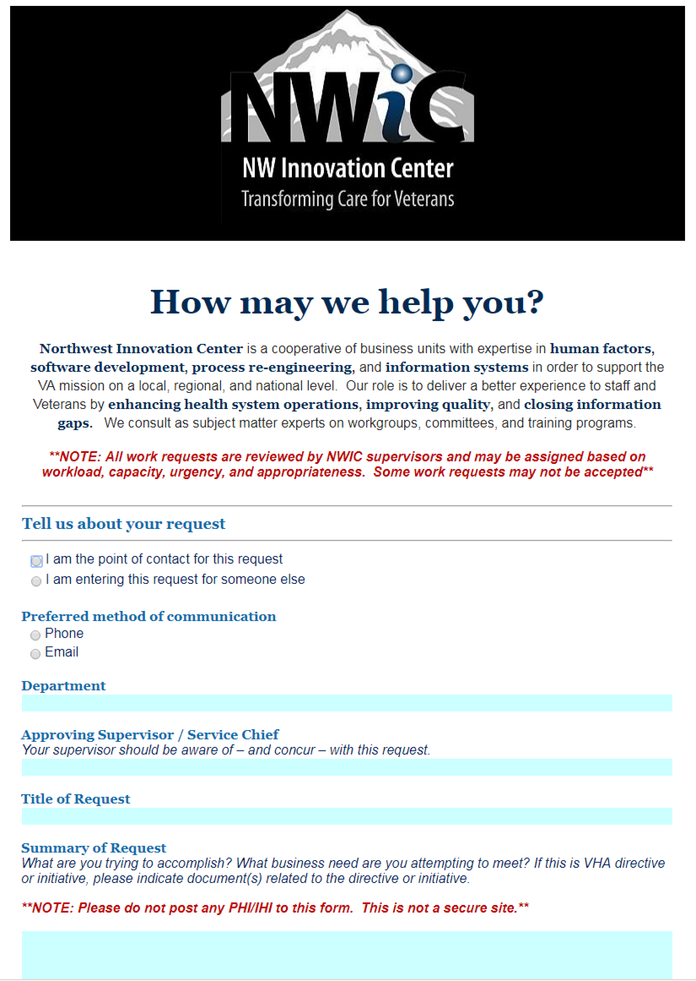
Notes:
[ ] The "Problems" slide that is showing is a variation on the "Who Cares" question of the Value Proposition

Slide 3
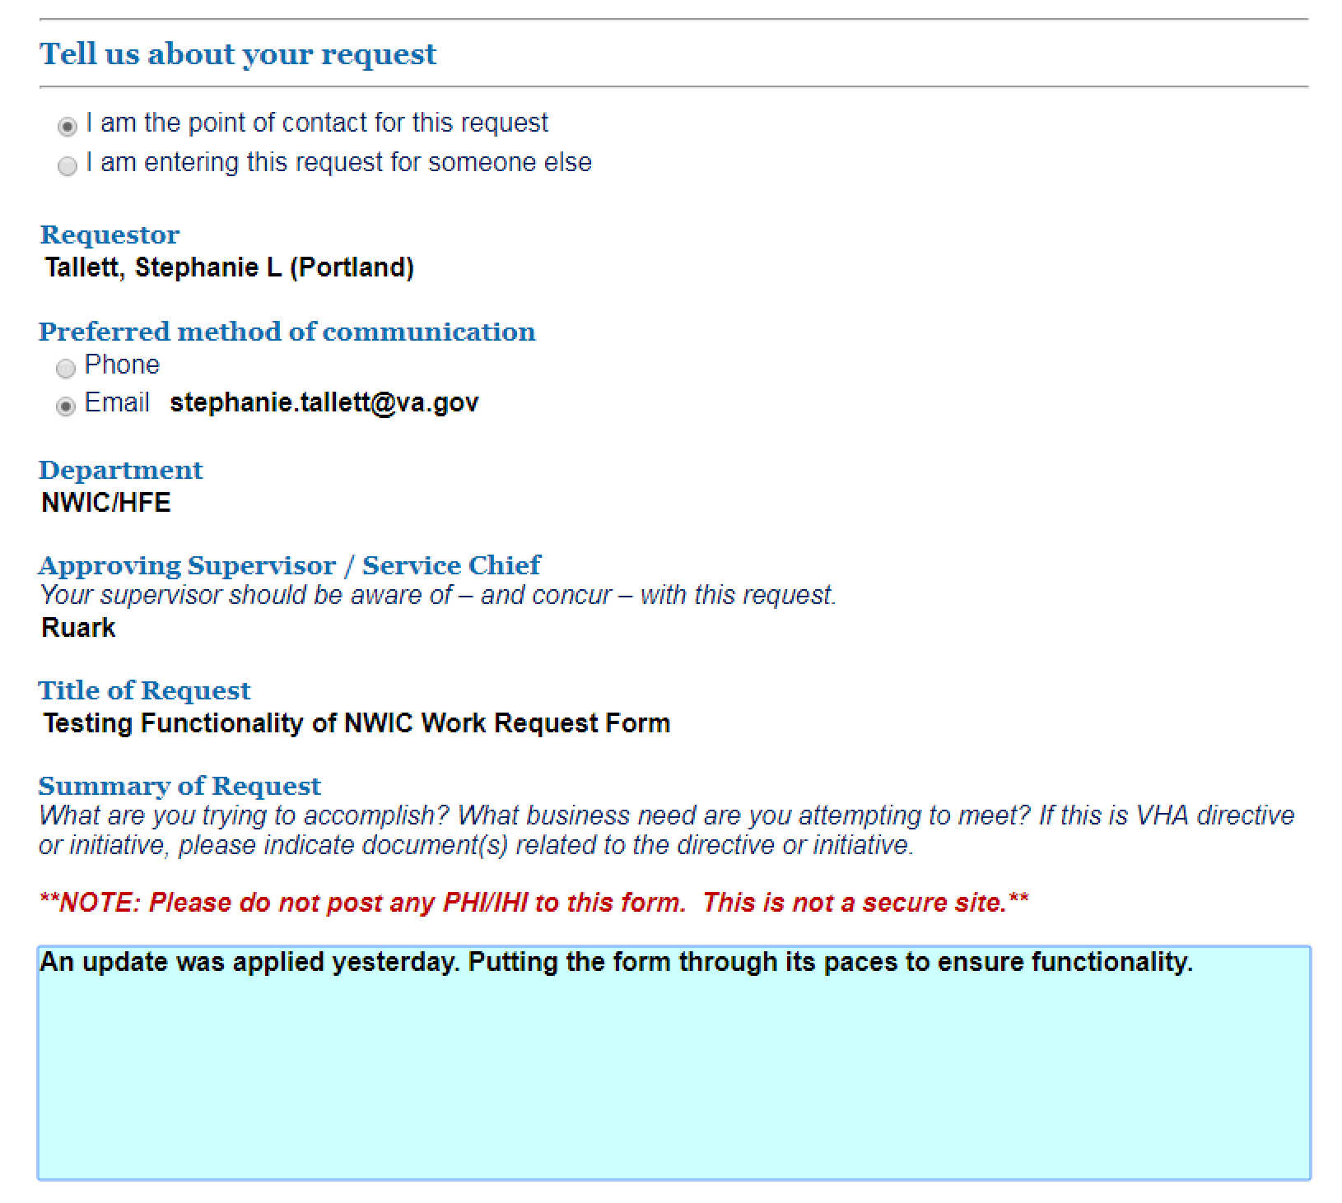
NWIC Intake Form: Goal 1
Standardize the project request intake process
Notes:
[ ] The "Problems" slide that is showing is a variation on the "Who Cares" question of the Value Proposition

Slide 4
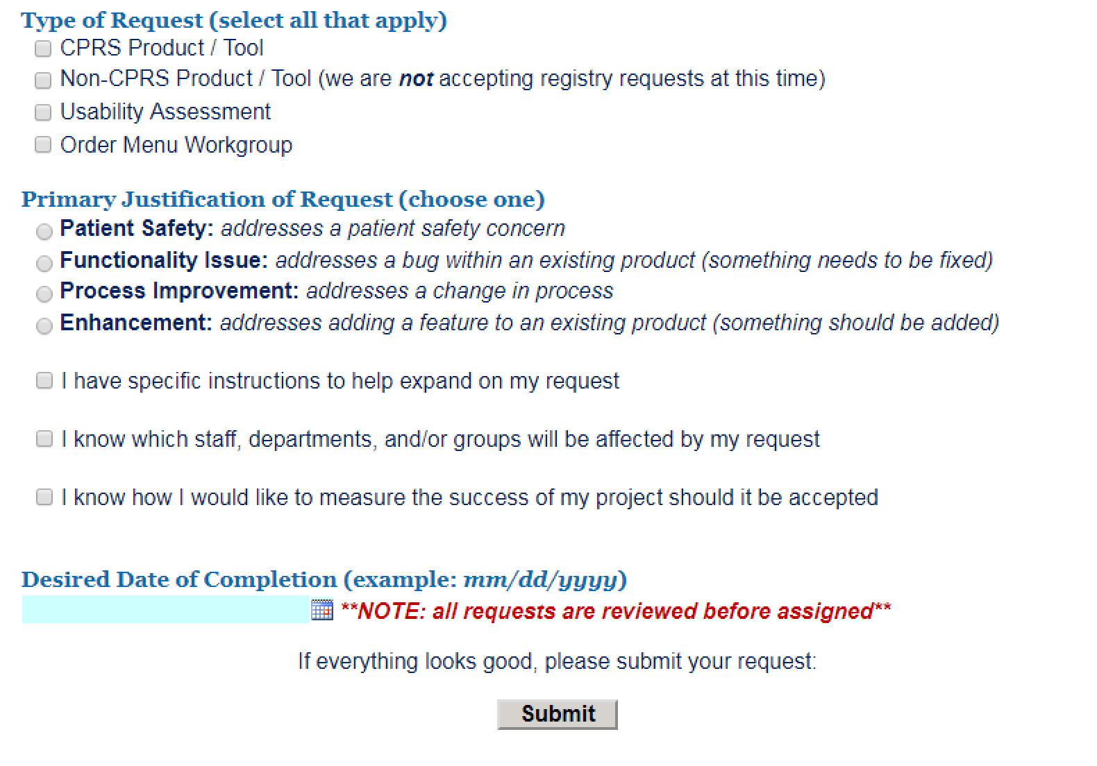
NWIC Intake Form: Goal 2
Collect salient information for prioritization & triage
Notes:
[ ] The "Problems" slide that is showing is a variation on the "Who Cares" question of the Value Proposition

Slide 5
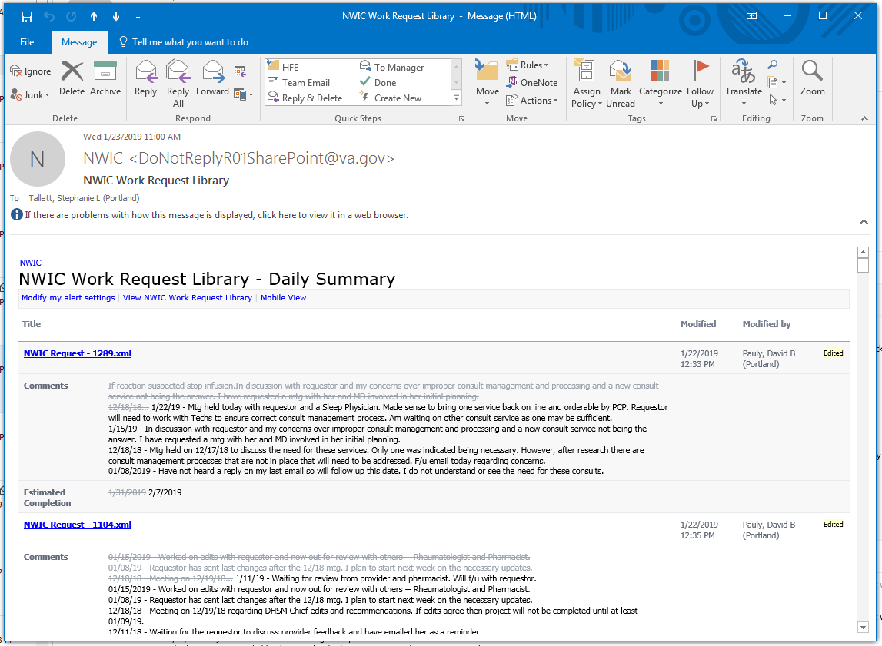
NWIC Intake Form: Goal 3
Document project status for leadership
Notes:
[ ] The "Problems" slide that is showing is a variation on the "Who Cares" question of the Value Proposition

Slide 6
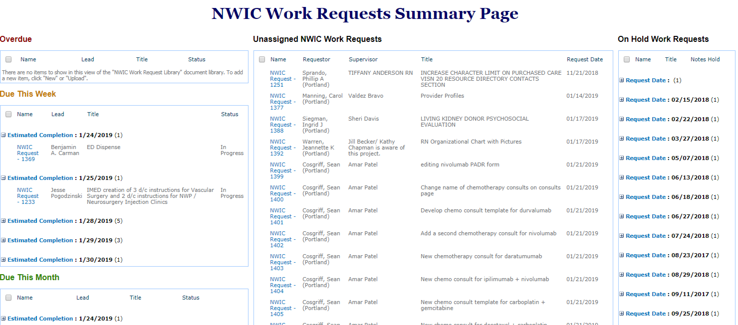
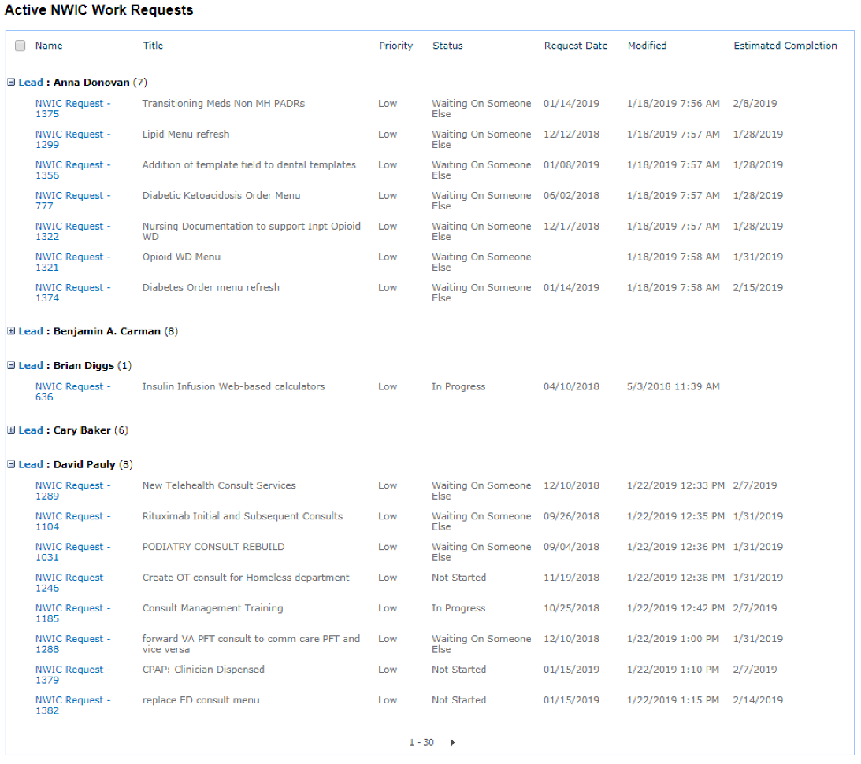
NWIC Intake Form: Goal 4
Access work distribution summary at a glance
Notes:
[ ] The "Problems" slide that is showing is a variation on the "Who Cares" question of the Value Proposition

Slide 7
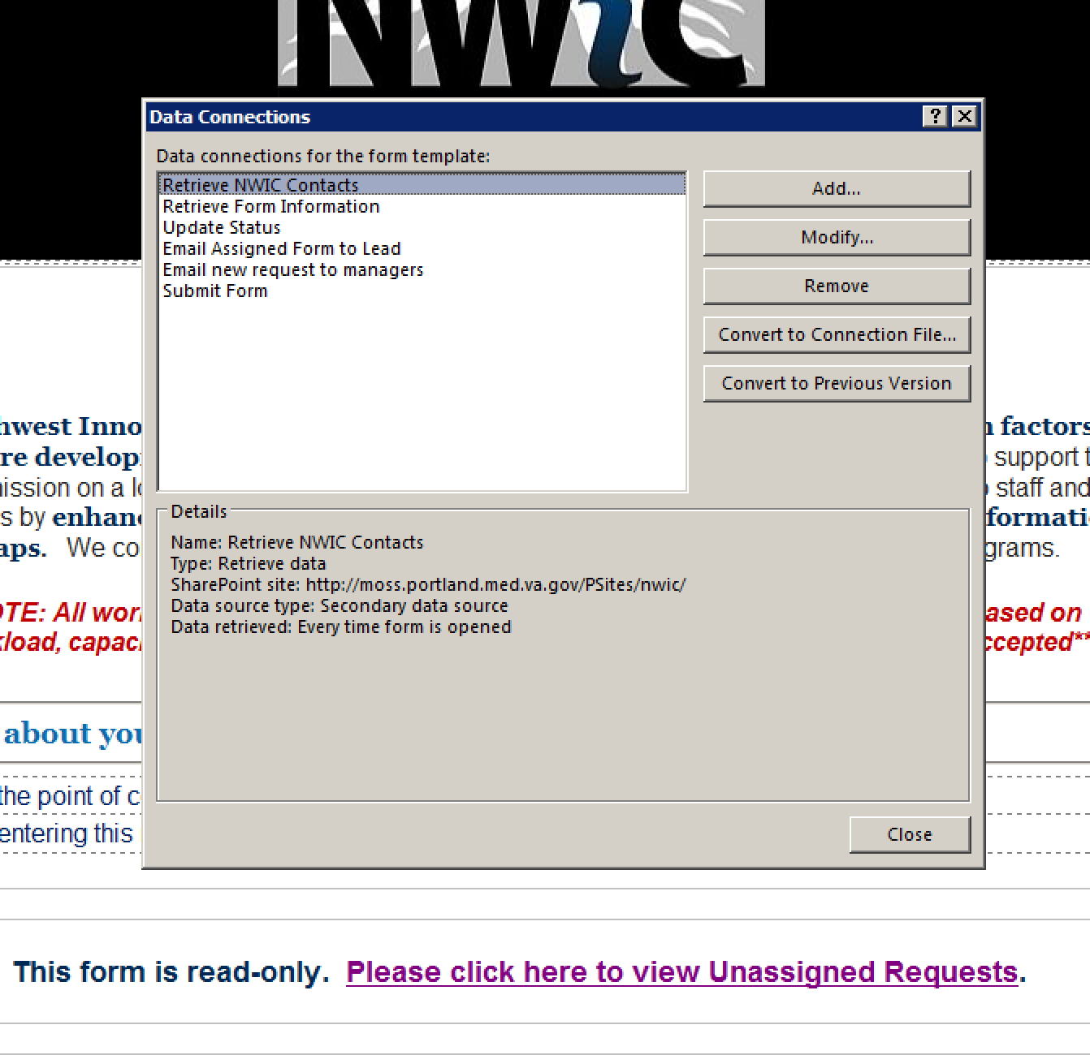
NWIC Intake Form: Features
Integrates InfoPath with SharePoint
Notes:
[ ] The "Problems" slide that is showing is a variation on the "Who Cares" question of the Value Proposition

Slide 8
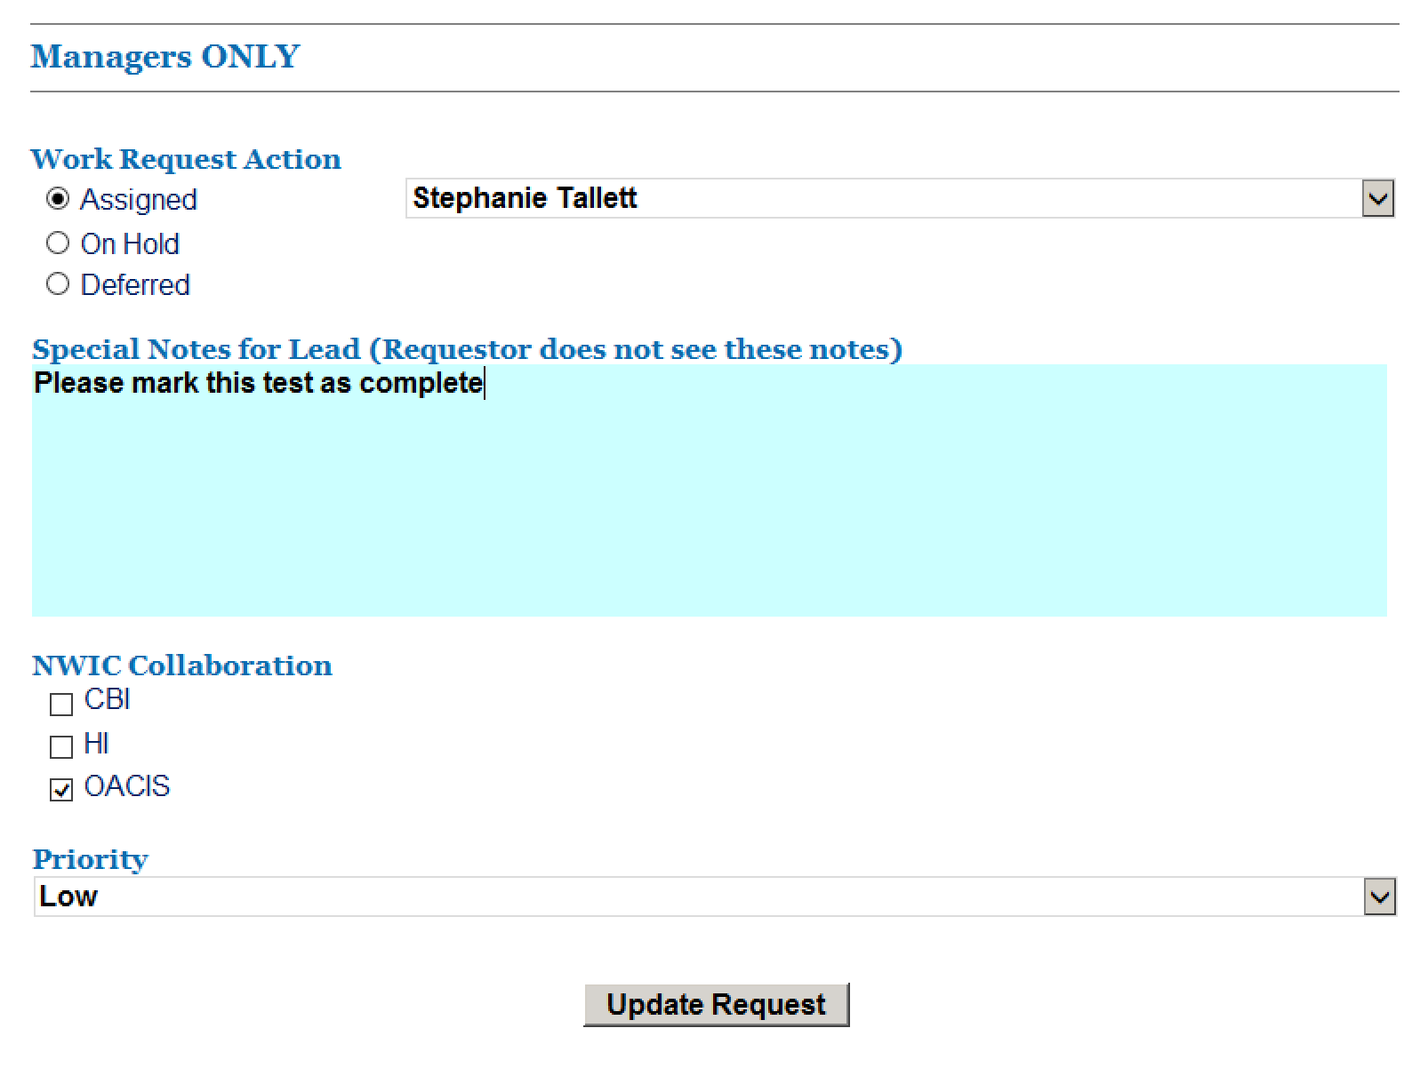
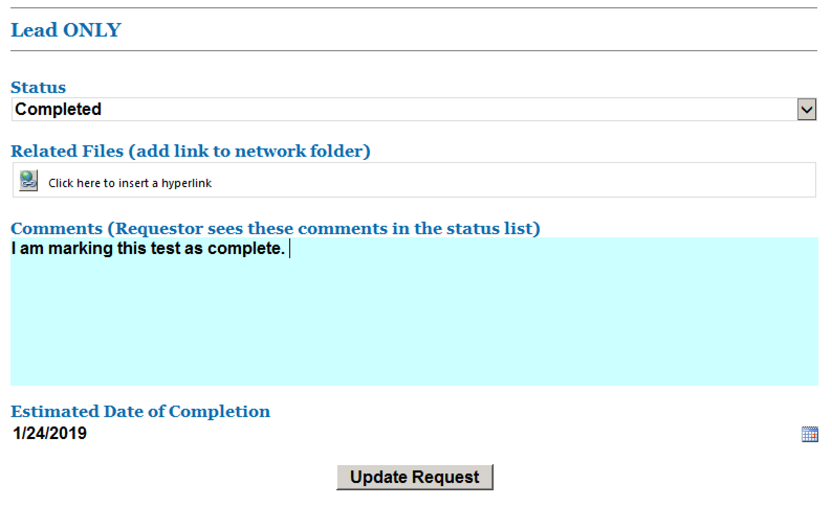
NWIC Intake Form: Features
3 views: Customer, Manager, Project Lead
Notes:
[ ] The "Problems" slide that is showing is a variation on the "Who Cares" question of the Value Proposition

Slide 9
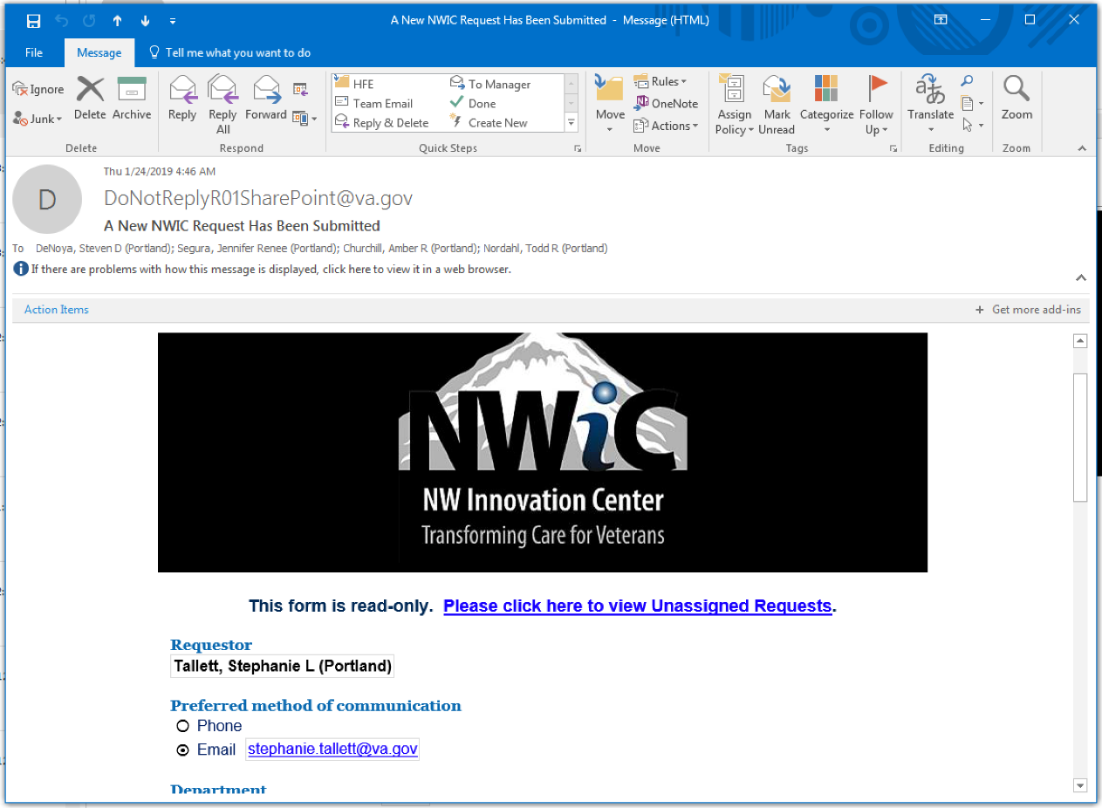
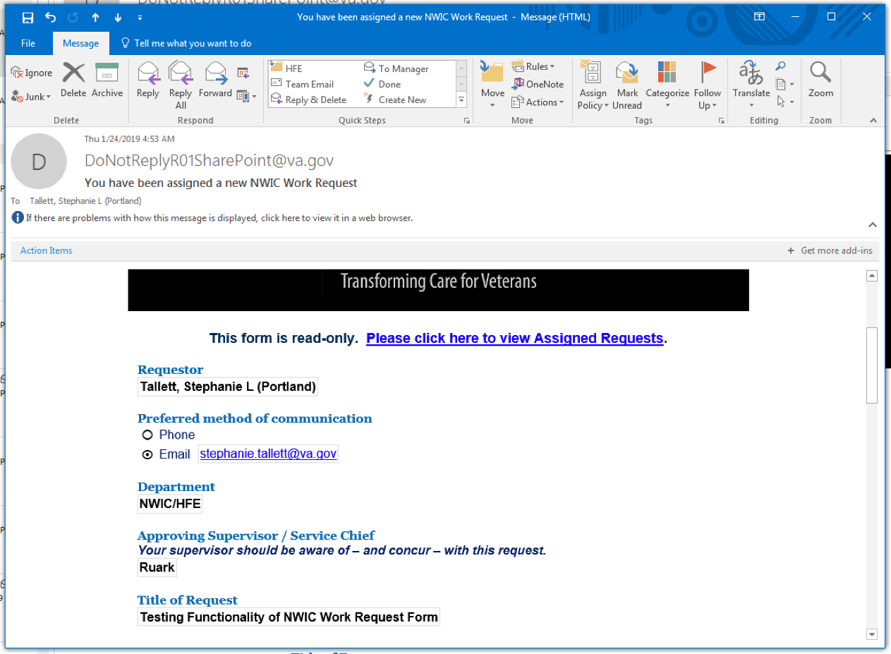
NWIC Intake Form: Features
Automated Email Updates
Notes:
[ ] The "Problems" slide that is showing is a variation on the "Who Cares" question of the Value Proposition

Slide 10
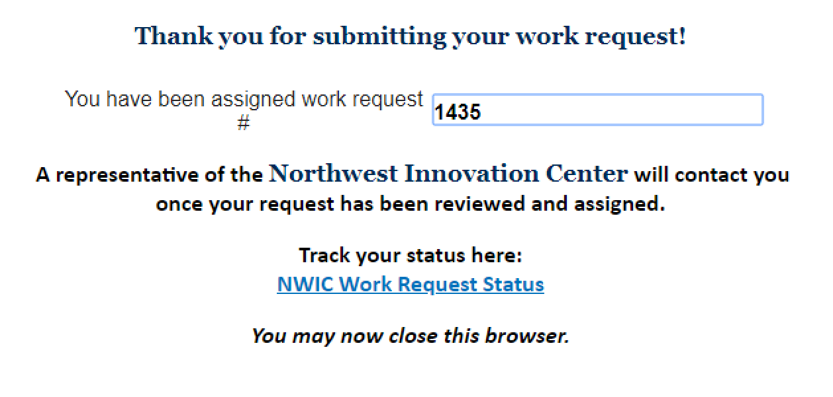
NWIC Intake Form: Features
Read-Only Public-Facing Status Updates
Notes:
[ ] The "Problems" slide that is showing is a variation on the "Who Cares" question of the Value Proposition

Slide 11
NWIC Intake Form: Process
Managers triage unassigned work request
Project lead gets an email notification
Update on project status is displayed on a customer-facing page
Project lead contacts customer for any clarification on needs or estimated delivery date
Project lead documents progress until the project is complete
Managers check project status and work distribution on a project summary page
Notes:
[ ] The "Problems" slide that is showing is a variation on the "Who Cares" question of the Value Proposition

